Slide 1

CMR TECHNICAL CAMPUS UGC-Autonomous
(Accredited by NAAC, NIRF, NBA, Permanently Affiliated to JNTUH, Approved by AICTE New Delhi)
Recognized Under Section 2(f) & 12(B of the UGC Act .1956 , Kandlakoya (V), Medchal Road, Hyderabad -501401.
DEPARTMENT OF COMPUTER SCIENCE AND ENGINEERING
Transfer Learning for Recognizing Face in Disguise
Under the guidance
of
Dr. A.Prabhu
PRESENTED BY
Abhinav Joel T 187R1A05C1
Adabala Taraka Rama Venkata Sai Hanuman 187R1A05C2
Daphedari Kishan Prasad 187R1A05D5

Slide 2
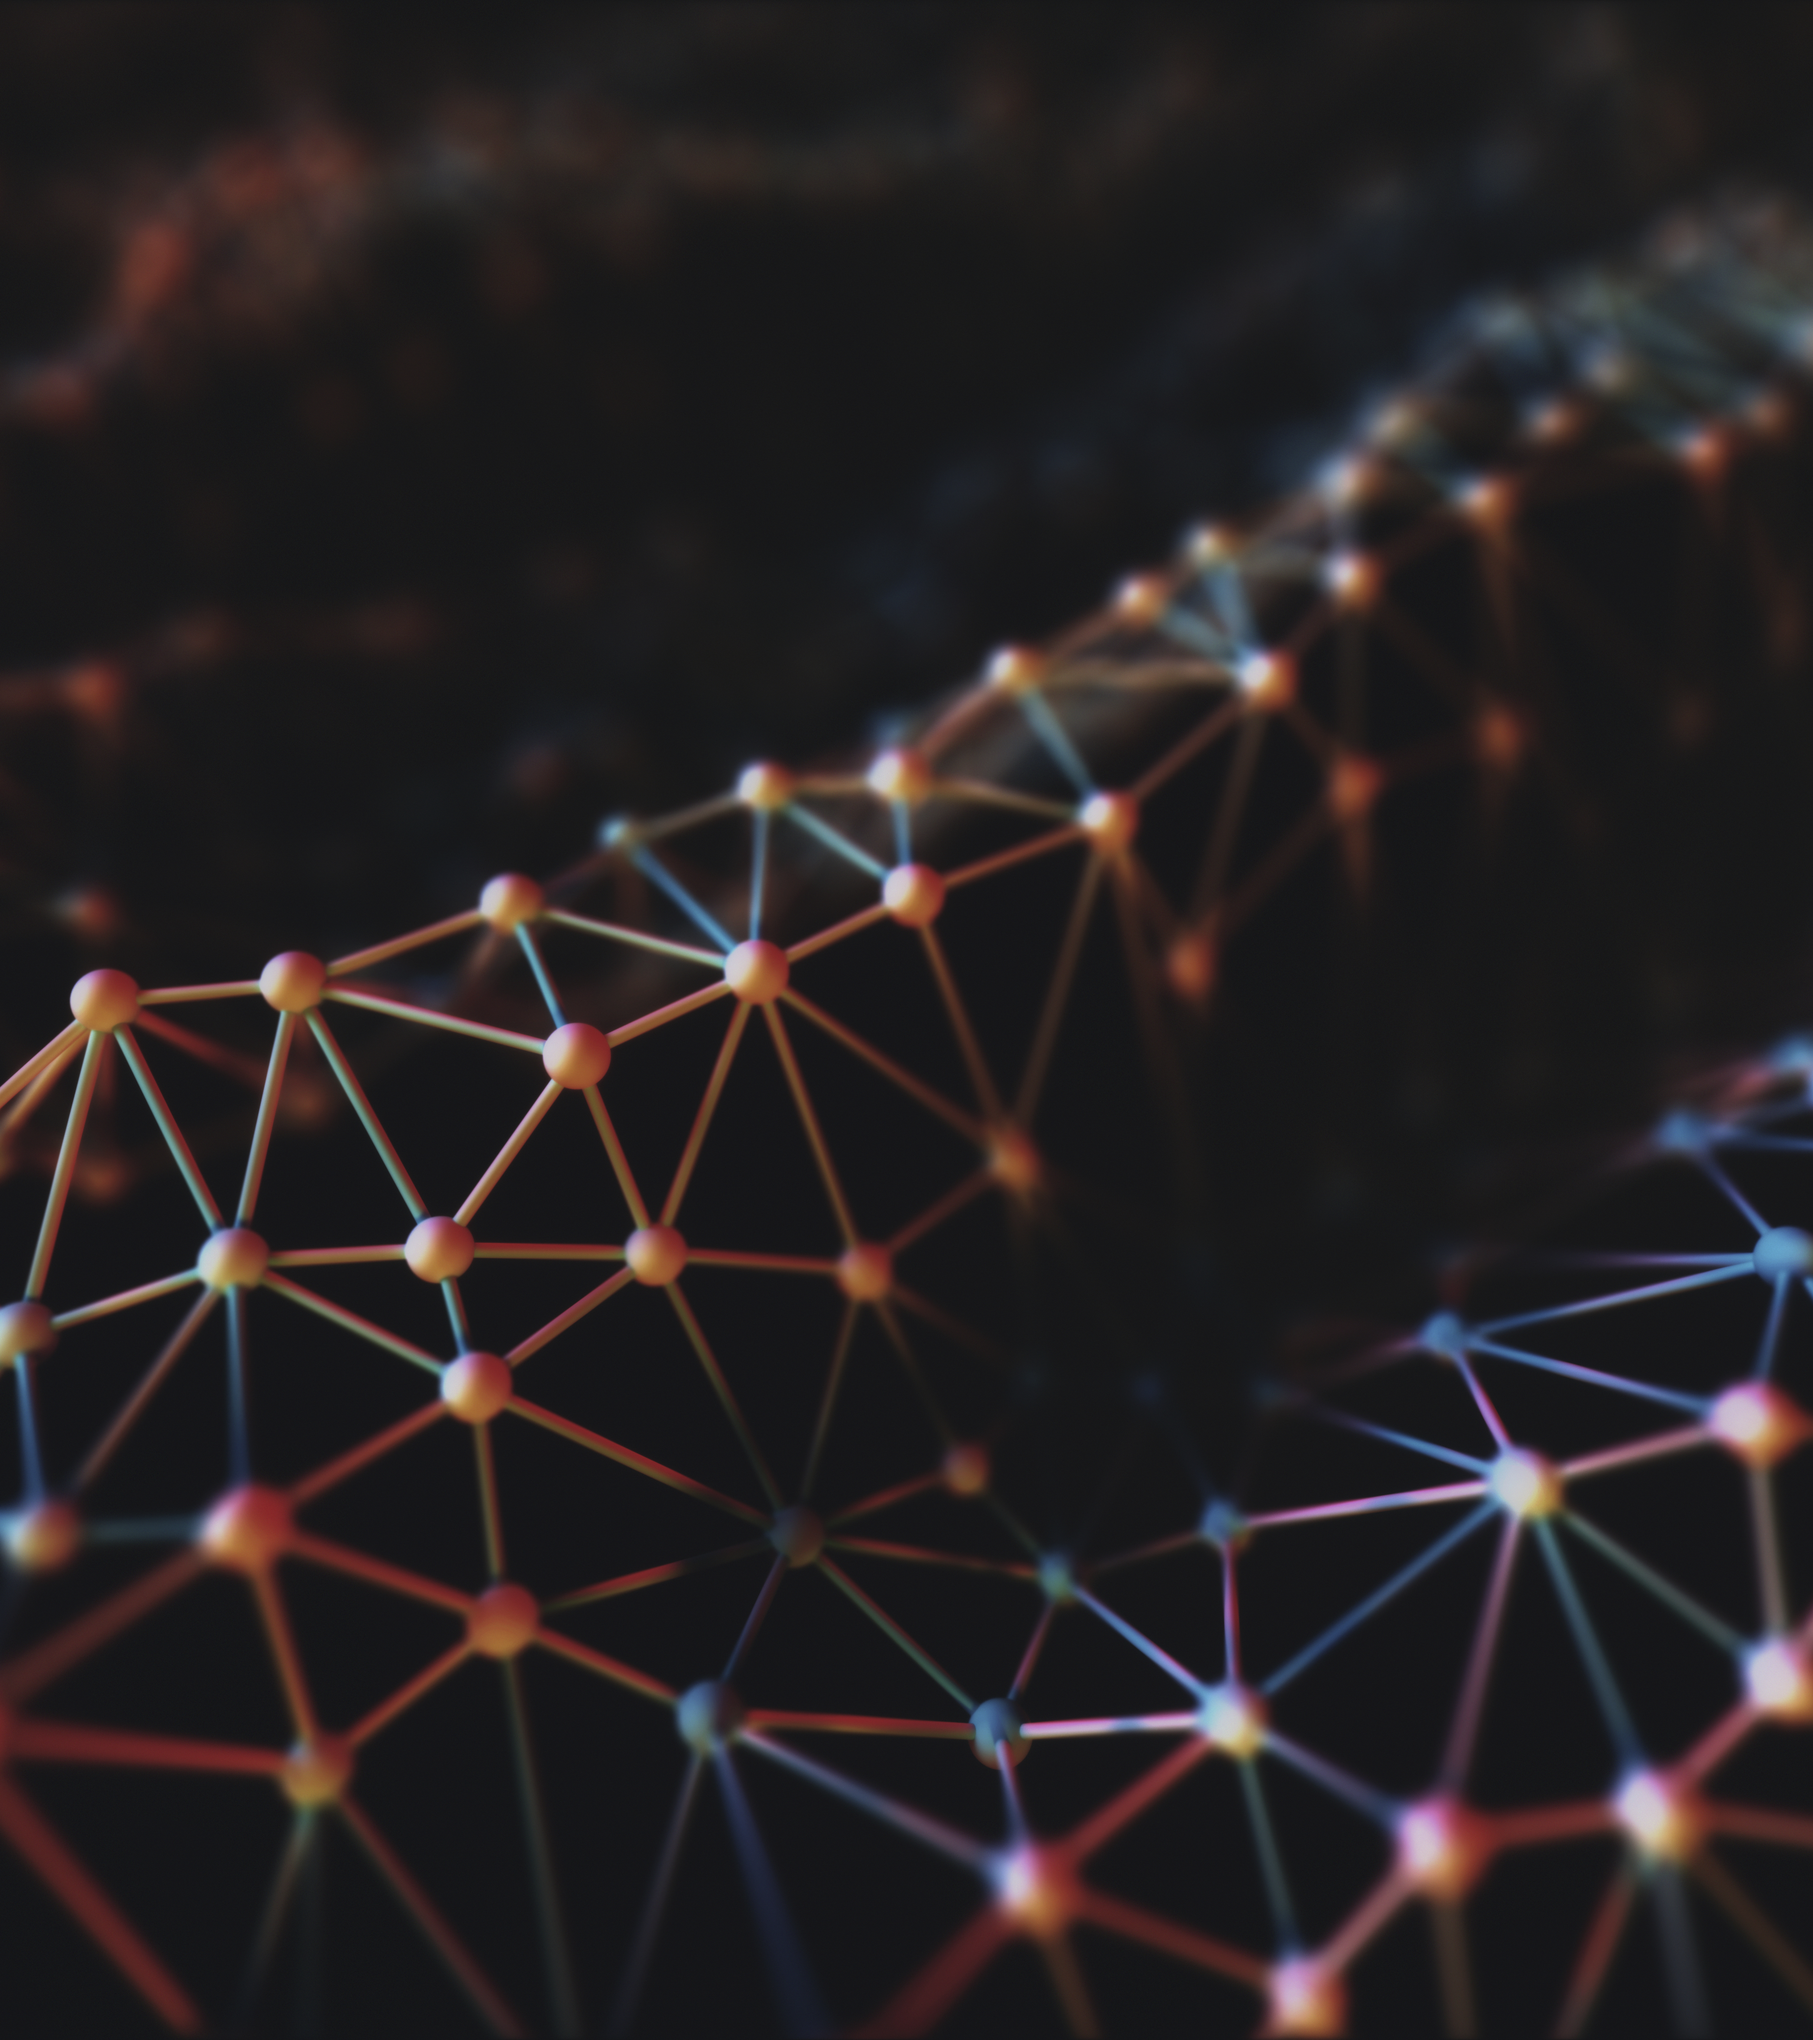
TABLE OF CONTENTS
ABSTRACT
EXISTING SYSTEM
DISADVANTAGES OF EXISTING SYSTEM
PROPOSED SYSTEM
ADVANTAGES OF PROPOSED SYSTEM
HARDWARE REQUIREMENTS
SOFTWARE REQUIREMENTS
PROJECT ARCHITECTURE
MODULES DESCRIPTION
UML DIAGRAMS
DATA FLOW DIAGRAM
SAMPLE CODE
CONCLUSION

Slide 3
ABSTRACT:
Face recognition is a method in Machine Learning to recognize objects in the picture or video. Humans have a memory to recognize other people and recognize some objects like animals, plants, living objects, and non-living objects. However, how the computer does that although it has memory? Machine Learning is the technique or method in Computer Vision that can be used, so computers can understand one person’s face to another person contained in the image or video. In this we proposes about testing some popular Convolutional Neural Network (CNN) Model Architecture to see which one is better to recognize the person face dataset in disguised. We use the “Recognizing Disguised Faces” dataset to distinguish 75 classes of faces, and then try to train and test how accurate it can be recognized by the machine, where it will be useful to anyone who needs to explore and develop an Architecture of Deep Learning. This project is expected to contribute to the field Machine Learning related algorithm that is used to solve the problem in image classification. The experimental results show significant improvement using transfer learning in VGG Models. We then conclude that ImageNet weight best used for face-recognizing using VGG Models.

Slide 4
EXISTING SYSTEM
In the Existing system disguise face detection uses PCA approach.
The PCA algorithm when compared with conventional PCA algorithm has an improved recognition rate for face images with large variations in lighting direction and facial expression.
In the PCA technique, the face images are divided into smaller sub-images and the PCA approach is applied to each of these sub-images. Since some of the local facial features of an individual do not vary even when the pose, lighting direction and facial expression vary.
We expect the proposed method to be able to cope with these variations.
The accuracy of the conventional PCA method and modular PCA method are evaluated under the conditions of varying expression, illumination and pose using standard face databases.

Slide 5
DISADVANTAGES OF EXISTING SYSTEM
Finding the eigenvectors and eigenvalues are time consuming on PCA.
The size and location of each face image must remain similar PCA (Eigenface) approach maps features to principal subspaces that contain most energy.
When a face-detection algorithm finds a face in an image or in a still from a video capture, the relative size of that face compared with the enrolled image size affects how well the face will be recognized.
Algorithm: Principal Component Analysis (PCA).

Slide 6
PROPOSED SYSTEM
In the proposed system, we compare some popular Pre-Trained CNN Model Architecture provided by Keras which is an opensource neural network library written in Python.
The architecture we used is VGG16, VGG19, ResNet50 and InceptionV3. Then, we divide into two parts: using the vector to train the classifier model, and evaluating the accuracy and cost function of the classifier model.
From this research, we expected to see the best PreTrained Architecture model with the highest level of accuracy, and the lowest cost function in the optimal hyperparameter state.
In transfer learning, the knowledge of an already trained machine learning model is applied to a different but related problem.
For example, if you trained a simple classifier to predict whether an image contains a backpack, you could use the knowledge that the model gained during its training to recognize other objects like sunglasses.

Slide 7
ADVANTAGES OF PROPOSED SYSTEM
With transfer learning a solid machine learning model can be built with comparatively little training data because the model is already pre-trained.
This is especially valuable in natural language processing because mostly expert knowledge is required to create large labeled datasets. Additionally, training time is reduced because it can sometimes take days or even weeks to train a deep neural network from scratch on a complex task.
Algorithm: CNN with VGG16, VGG19, ResNet50 and Inceptionv3.

Slide 8
HARDWARE REQUIREMENTS
System : intel core i5
Hard Disk : 1 TB
Input Devices : Keyboard, Mouse
Ram : 8GB

Slide 9
SOFTWARE REQUIREMENTS
Operating system : Windows 8,10/ MacOS
Coding Language : Python
Tool : PyCharm CE

Slide 10
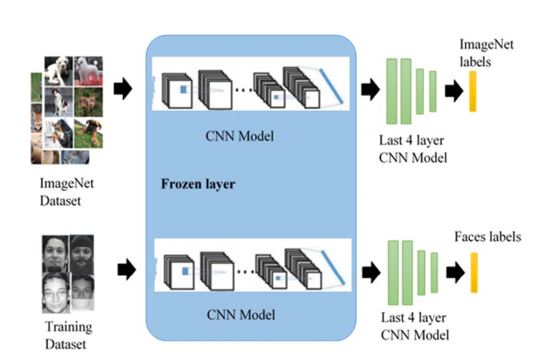
PROJECT ARCHITECTURE

Slide 11
MODULES DESCRIPTION
User
Vgg16
ResNet50
InceptionV3

Slide 12
User:
The User can collect the images from web surfing in the data folder training, testing and validation images are available. These are classified into 3 classes those are disguise, mask and scarf.
Now user has to create the objects of Vgg16 and Vgg19 and generate models weight filed call .h5 file.
This h5 file contain all the weights of our models. At the time of generating h5 file the los function, loss accuracy, accuracy and test accuracy will be displayed in the graph and execution time.
User can test the object detection from a video file or system camera.
To process this user required high configuration system. User can test images by help of generated models weights files.

Slide 13
VGG16:
The Vgg16 architecture comes from the VGG group, Oxford. VGG was made to improve from the AlexNet architecture by replacing large kernel filters (11 and 5 in the first and second convolutional layers) with some 3x3 kernel filters.
With a given receptive field, small-sized kernels that are stacked are better than large-size kernels, because several non-linear layers increase the depth of the network which makes it possible to learn more complex feature.

Slide 14
ResNet50:
In accordance with what has been discussed so far, namely, to improve accuracy in the network must increase the depth of the layer, as long as it can keep over-fitting. However, increasing the deep network does not work by simply adding layers.
Deep networks are difficult to practice because of the problem of vanishing gradients, where gradients are repropagated to the previous layer, repeated repetition can make the gradient very small.
As a result, as the network grows, the performance becomes saturated or even begins to degrade quickly. the basic idea of ResNet (Residual Network) is to introduce what is called an "identity shortcut connection" that passes through one or more layer.

Slide 15
InceptionV3:
VGG achieved phenomenal accuracy in the ImageNet dataset, but its use requires high computation, even though it uses a GPU (Graphic Processing Unit). This has become inefficient due to the large width of the convolutional layer used.
GoogLeNet builds on the idea that most activations in deep networks are not needed (zero value) or excessive because of the correlation between them. Therefore, the most efficient deep network architecture will have sparse connections between activations, which implies that all 512 output channels will not have connections between each other.
GoogLeNet designed a module called the Inception module which numbered roughly like a thin CNN with a solid construction. Because only a small fraction of the neurons is effective as mentioned previously, the width/number of convolutional filters of the kernel size is kept small. This module also uses convolution of various sizes to capture details at various scales.

Slide 16
UML DIAGRAMS
USE CASE DIAGRAM
CLASS DIAGRAM
SEQUENCE DIAGRAM
ACTIVITY DIAGRAM

Slide 17
USE CASE DIAGRAM

Slide 18
CLASS DIAGRAM

Slide 19
SEQUENCE DIAGRAM

Slide 20
ACTIVITY DIAGRAM

Slide 21
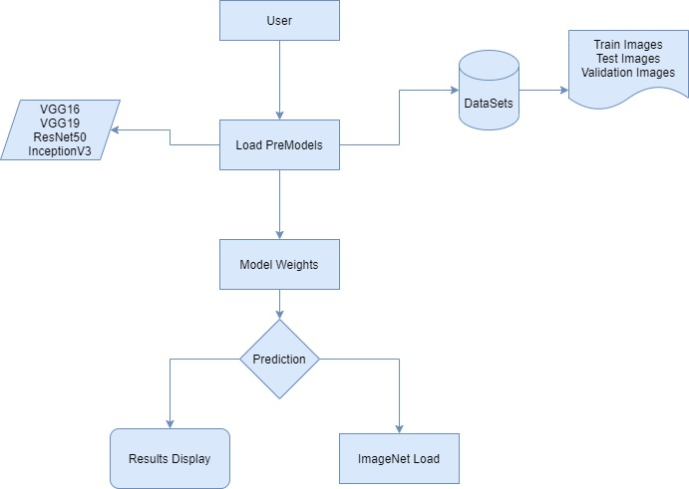
DATA FLOW DIAGRAM

Slide 22
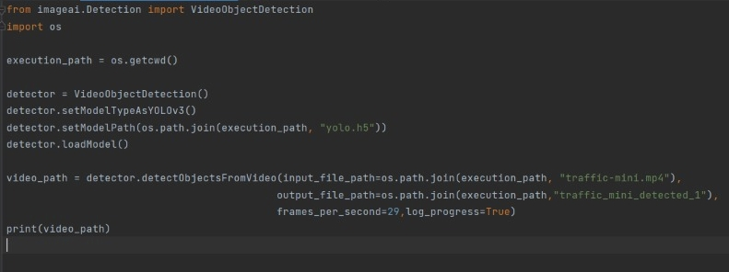
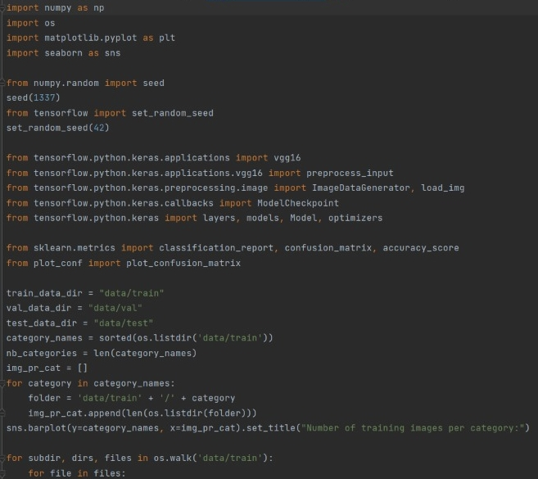
SAMPLE CODE

Slide 23
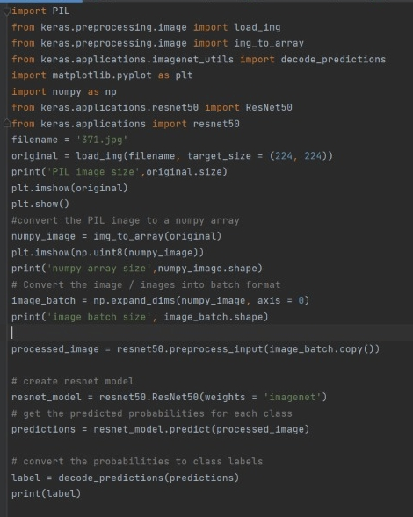
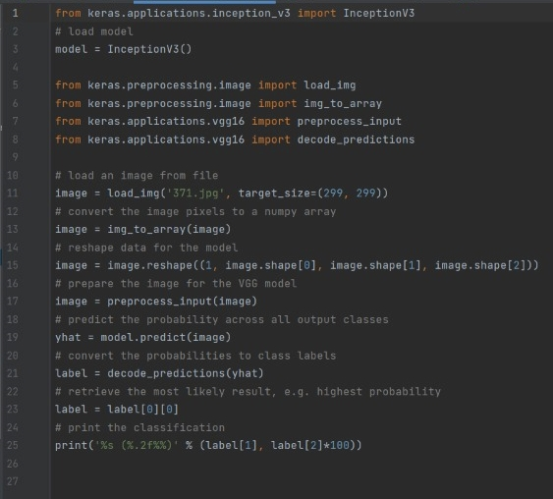

Slide 24
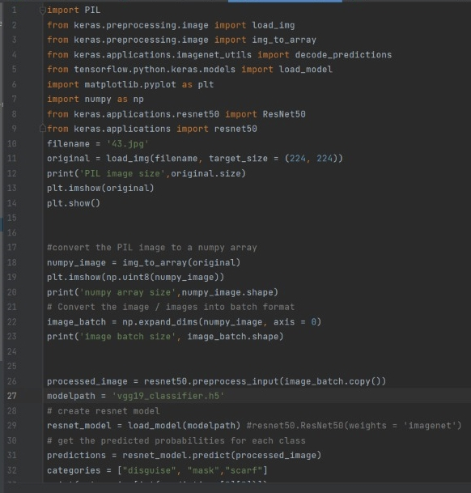

Slide 25
CONCLUSION
In this system, we compare some popular Pre-Trained CNN Model Architecture provided by Keras which is an opensource neural network library written in Python.
The architecture we used is VGG16, VGG19, ResNet50 and InceptionV3.
This is especially valuable in natural language processing because mostly expert knowledge is required to create large labeled datasets.

Slide 26

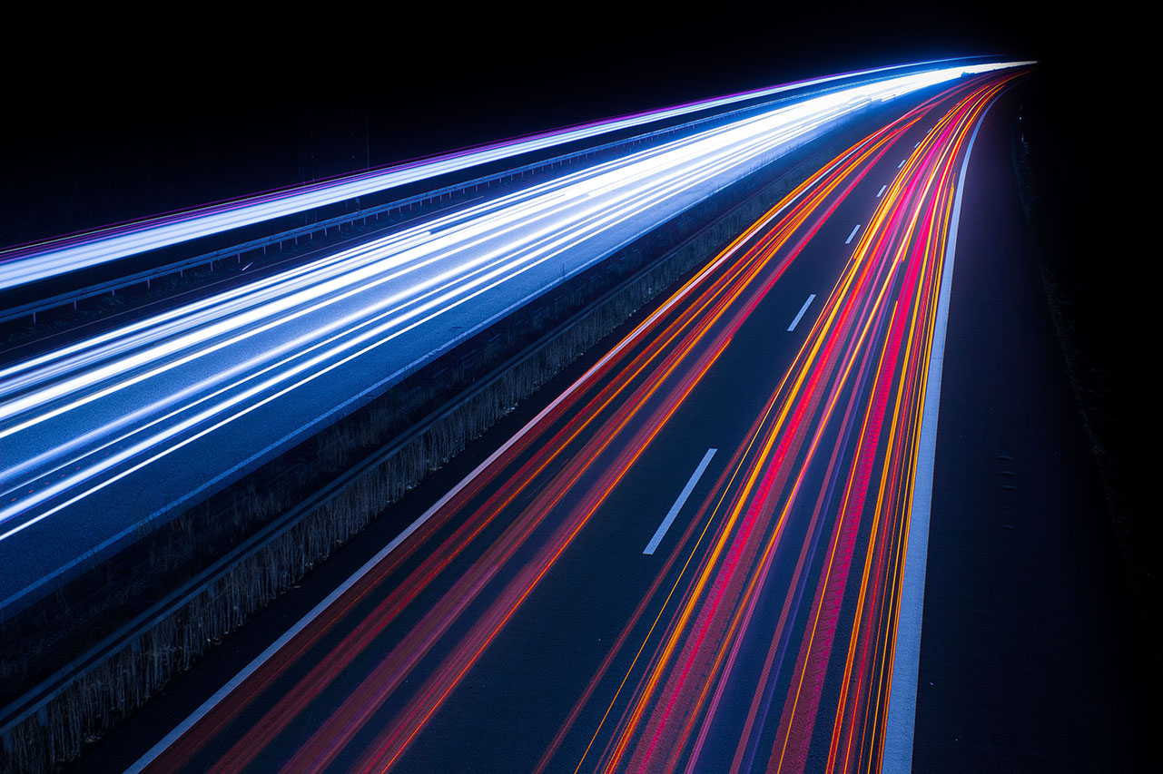
Thank You!

